Slide 1

TITLE OF CORNER STONE PROJECT
A CORNER STONE PROECT REPORT
submitted by
AARON TOM ALEX(REGISTER NO) ABEL C GEORGE(REGISTER NO) (REGISTER NO)
to
the APJ Abdul Kalam Technological University
in partial fulfillment of the requirement for the award of the Degree
of
Bachelor of Technology
in
Computer Science and Engineering
Department of Computer Science and Engineering Amal Jyothi College of Engineering(Autonomous) Kanjirappally-686518
December 2024

Slide 2
DEPT. OF COMPUTER SCIENCE AND ENGINEERING
AMAL JYOTHI COLLEGE OF ENGINEERING(AUTONOMOUS) KANJIRAPPALLY
CERTIFICATE
This is to certify that the corner stone project report entitled “ project Title ” submitted by Student Name (Register No.), Student Name (Register No.) and Student Name (Register No.) to the APJ Abdul Kalam Technological University in partial fulfillment of the requirements for the award of the Degree of Bachelor of Technology in Computer Sci-ence and Engineering during the year 2024-2025, is a bonafide work carried out by him/her under my guidance and supervision.
Dr. Jayakrishna V
Subject Teacher
Dr.Juby Mathew
Head of Department, CSE

Slide 3
AIM
The aim of a sorting visualizer is to provide an interactive and educational tool that helps users understand how different sorting algorithms work. By visually demonstrating the step-by-step process of sorting, users can gain a deeper insight into the mechanics and efficiency of various algorithms.
FUNTIONALITY
Visual Representation:
Animates the sorting process, showing how elements are rearranged in real-time.
Multiple Algorithms:
Supports various sorting techniques such as Bubble Sort, Selection Sort, Insertion Sort, Merge Sort, Quick Sort, and Heap Sort.
Customizable Parameters:
Allows users to adjust array size, sorting speed, and value range for a personalized experience.
Performance Metrics:
Displays metrics like comparisons, swaps, and time complexity during the sorting process.
User-Friendly Interface:
Provides an intuitive interface with interactive controls for easy navigation and interaction.
Educational Tool:
Serves as a learning resource for students, developers, and anyone interested in understanding sorting algorithms through hands-on experimentation.

Slide 4
ALGORITHM

Slide 5
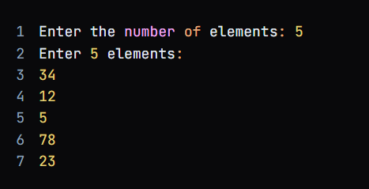
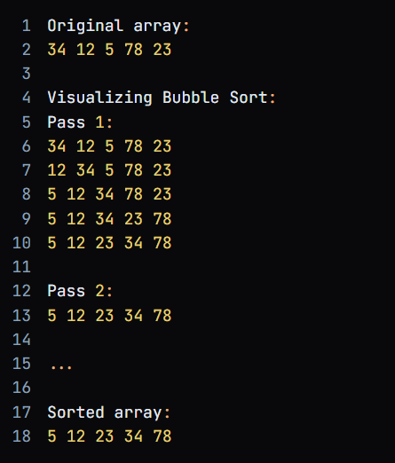
EXPECTED OUTPUTS BASED ON
INPUT WITH EXCEPTIONS
BUBBLE SORT
INPUT:
EXPECTED OUTPUT:

Slide 6
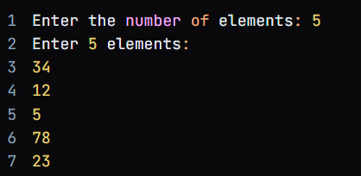
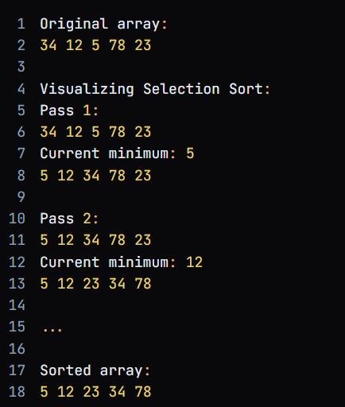
SELECTION SORT
INPUT:
EXPECTED OUTPUT:

Slide 7
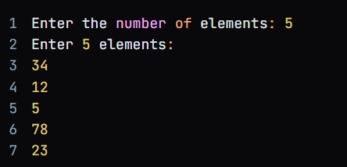
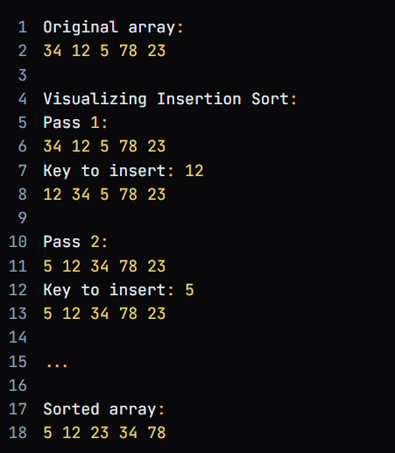
INSERTION SORT
INPUT:
EXPECTED OUTPUT:

Slide 8
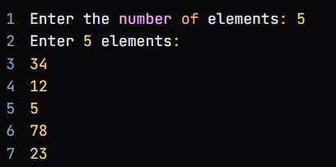
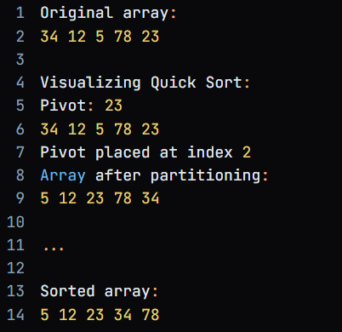
QUICK SORT
INPUT:
EXPECTED OUTPUT:

Slide 9
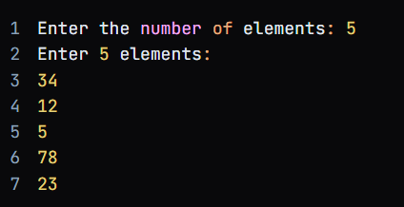
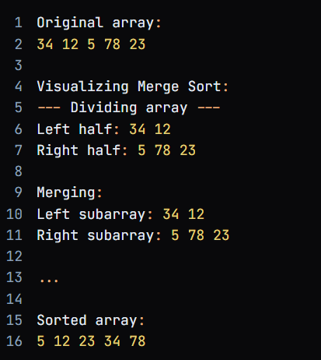
MERGE SORT
INPUT:
EXPECTED OUTPUT:

Slide 10
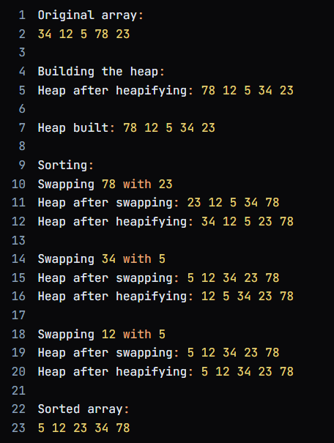
HEAP SORT
INPUT:
EXPECTED OUTPUT:

Slide 11



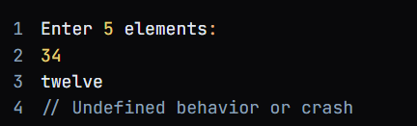
EXCEPTION HANDLING:
The exceptions are same for all the sorting algorithms.
INVALID INPUT FOR NUMBER OF ELEMENTS:
INVALID INPUTS FOR ARRAY ELEMENTS:

Slide 12
PROGRAM
#include <stdio.h>
#include <unistd.h>
#define MAX_SIZE 10
// ANSI color codes for highlighting
#define RESET_COLOR "\033[0m“
#define BUBBLE_HIGHLIGHT "\033[1;33m“
#define SELECT_HIGHLIGHT "\033[1;34m“
#define MIN_COLOR "\033[1;31m“
#define INSERT_HIGHLIGHT "\033[1;32m"
#define PIVOT_COLOR "\033[1;35m"
#define MERGE_HIGHLIGHT "\033[1;36m"
#define HEAP_HIGHLIGHT "\033[38;5;214m"
void printArray(int arr[], int size, int highlight1, int highlight2,
char* color1, char* color2) {
for (int i = 0; i < size; i++) {
if (i == highlight1) {
printf("%s%d%s ", color1, arr[i], RESET_COLOR);
} else if (i == highlight2) {
printf("%s%d%s ", color2, arr[i], RESET_COLOR);
} else {
printf("%d ", arr[i]);
}
}
printf("\n");
}
void printmergeArray(int arr[], int size, int left, int right, int highlightIndex) {
for (int i = left; i <= right; i++) {

Slide 13
if (i == highlightIndex) {
printf(MERGE_HIGHLIGHT "%d" RESET_COLOR " ", arr[i]);
} else {
printf("%d ", arr[i]);
}
}
printf("\n");
}
void bubbleSort(int arr[], int size) {
printf("Visualizing Bubble Sort:\n");
for (int i = 0; i < size - 1; i++) {
printf("Pass %d:\n", i + 1);
for (int j = 0; j < size - i - 1; j++) {
printArray(arr, size, j, j + 1, BUBBLE_HIGHLIGHT,
BUBBLE_HIGHLIGHT);
usleep(1000000);
if (arr[j] > arr[j + 1]) {
// Swap elements
int temp = arr[j];
arr[j] = arr[j + 1];
arr[j + 1] = temp;
printArray(arr, size, j, j + 1, BUBBLE_HIGHLIGHT,
BUBBLE_HIGHLIGHT);
usleep(1000000);
}
}
printf("\n");
}
}
void selectionSort(int arr[], int size) {
printf("Visualizing Selection Sort:\n");
for (int i = 0; i < size - 1; i++) {

Slide 14
int minIndex = i;
printf("Pass %d:\n", i + 1);
printArray(arr, size, -1, minIndex, MIN_COLOR, SELECT_HIGHLIGHT);
usleep(1000000);
for (int j = i + 1; j < size; j++) {
printArray(arr, size, j, minIndex, SELECT_HIGHLIGHT, MIN_COLOR);
usleep(1000000);
if (arr[j] < arr[minIndex]) {
minIndex = j;
printArray(arr, size, j, minIndex, MIN_COLOR
, SELECT_HIGHLIGHT);
usleep(1000000);
}
}
if (minIndex != i) {
int temp = arr[i];
arr[i] = arr[minIndex];
arr[minIndex] = temp;
printArray(arr, size, -1, minIndex, MIN_COLOR, SELECT_HIGHLIGHT);
usleep(1000000);
}
printf("Array after Pass %d:\n", i + 1);
printArray(arr, size, -1, -1, "", "");
usleep(1000000);
printf("\n");
}
}

Slide 15
void insertionSort(int arr[], int size) {
printf("Visualizing Insertion Sort:\n");
for (int i = 1; i < size; i++) {
int key = arr[i];
int j = i - 1;
printf("Pass %d:\n", i);
printArray(arr, size, i, -1, INSERT_HIGHLIGHT, "");
usleep(1000000);
while (j >= 0 && arr[j] > key) {
arr[j + 1] = arr[j];
printArray(arr, size, j, j + 1, INSERT_HIGHLIGHT, INSERT_HIGHLIGHT);
usleep(1000000);
j--;
}
arr[j + 1] = key;
printArray(arr, size, j + 1, -1, INSERT_HIGHLIGHT, "");
usleep(1000000);
printf("\n");
}
}
int partition(int arr[], int low, int high) {
int pivot = arr[high];
int i = low - 1;
printf("Pivot: ");
printArray(arr, high - low + 1, high, -1, PIVOT_COLOR, 0);
usleep(1000000);
for (int j = low; j < high; j++) {
printArray(arr, high - low + 1, j, high, 0, PIVOT_COLOR);
usleep(1000000);
if (arr[j] < pivot) {
i++;

Slide 16
int temp = arr[i];
arr[i] = arr[j];
arr[j] = temp;
printArray(arr, high - low + 1, i, j, PIVOT_COLOR, 0);
usleep(1000000); // Pause to show swap
}
}
int temp = arr[i + 1];
arr[i + 1] = arr[high];
arr[high] = temp;
printArray(arr, high - low + 1, i + 1, high, PIVOT_COLOR, 0);
usleep(1000000);
return i + 1;
}
void quickSort(int arr[], int low, int high) {
if (low < high) {
int pi = partition(arr, low, high);
printf("Array after partitioning:\n");
printArray(arr, high - low + 1, -1, -1, 0, 0);
usleep(1000000);
quickSort(arr, low, pi - 1);
quickSort(arr, pi + 1, high);
}
}
void merge(int arr[], int left, int mid, int right) {
int n1 = mid - left + 1;
int n2 = right - mid;
int L[n1], R[n2];
for (int i = 0; i < n1; i++)
L[i] = arr[left + i];
for (int j = 0; j < n2; j++)
R[j] = arr[mid + 1 + j];
printf("\nMerging:\n");

Slide 17
printf("Left subarray: ");
for (int i = 0; i < n1; i++){
printf("%d ", L[i]);
usleep(1000000);
}
printf("\nRight subarray: ");
for (int j = 0; j < n2; j++){
printf("%d ", R[j]);
usleep(1000000);
}
printf("\n");
int i = 0, j = 0, k = left;
while (i < n1 && j < n2) {
if (L[i] <= R[j]) {
arr[k] = L[i];
printmergeArray(arr, right - left + 1, left, right,k);
usleep(1000000);
i++;
} else {
arr[k] = R[j];
printmergeArray(arr, right - left + 1, left, right, k);
usleep(1000000);
j++;
}
k++;
}
while (i < n1) {
arr[k] = L[i];
printmergeArray(arr, right - left + 1, left, right, k);
usleep(1000000);
i++;
k++;
}

Slide 18
while (j < n2) {
arr[k] = R[j];
printmergeArray(arr, right - left + 1, left, right, k);
usleep(1000000);
j++;
k++;
}
}
void mergeSort(int arr[], int left, int right) {
if (left < right) {
int mid = left + (right - left) / 2;
printf("\n--- Dividing array ---\n");
printf("Left half: ");
for (int i = left; i <= mid; i++){
printf("%d ", arr[i]);
usleep(1000000);
}
printf("\nRight half: ");
for (int i = mid + 1; i <= right; i++){
printf("%d ", arr[i]);
usleep(1000000);
}
printf("\n");
mergeSort(arr, left, mid);
mergeSort(arr, mid + 1, right);
merge(arr, left, mid, right);
}
}
void heapify(int arr[], int size, int root) {
int largest = root;
int left = 2 * root + 1;
int right = 2 * root + 2;
if (left < size && arr[left] > arr[largest])

Slide 19
largest = left;
if (right < size && arr[right] > arr[largest])
largest = right;
if (largest != root) {
int temp = arr[root];
arr[root] = arr[largest];
arr[largest] = temp;
printArray(arr, size, root, largest, HEAP_HIGHLIGHT, HEAP_HIGHLIGHT);
usleep(1000000);
heapify(arr, size, largest);
}
}
void heapSort(int arr[], int size) {
printf("Visualizing Heap Sort:\n");
for (int i = size / 2 - 1; i >= 0; i--) {
heapify(arr, size, i);
}
for (int i = size - 1; i > 0; i--) {
int temp = arr[0];
arr[0] = arr[i];
arr[i] = temp;
printArray(arr, size, 0, i, HEAP_HIGHLIGHT, HEAP_HIGHLIGHT);
usleep(1000000);
heapify(arr, i, 0);
}
}
void main() {
int size;
printf("Enter the number of elements: ");
scanf("%d", &size);
int arr[size];

Slide 20
int choice;
char continueChoice;
do {
printf("Enter %d elements:\n", size);
for (int i = 0; i < size; i++) {
scanf("%d", &arr[i]);
}
printf("Choose a sorting algorithm to visualize:\n");
printf("1. Bubble Sort\n");
printf("2. Selection Sort\n");
printf("3. Insertion Sort\n");
printf("4. Quick Sort\n");
printf("5. Merge Sort\n");
printf("6. Heap Sort\n");
printf("Enter your choice: ");
scanf("%d", &choice);
printf("Original array:\n");
printArray(arr, size, -1, -1, "", "");
printf("\n");
switch (choice) {
case 1:
bubbleSort(arr, size);
break;
case 2:
selectionSort(arr, size);
break;
case 3:
insertionSort(arr, size);
break;
case 4:
quickSort(arr, 0, size - 1);
break;

Slide 21
case 5:
mergeSort(arr, 0, size - 1);
break;
case 6:
heapSort(arr, size);
break;
default:
printf("Invalid choice!\n");
}
printf("Sorted array:\n");
printArray(arr, size, -1, -1, "", "");
printf("Do you want to sort the array again? (y/n): ");
scanf(" %c", &continueChoice);
if(continueChoice == 'n' || continueChoice == 'N'){
printf("Sorting complete!\n");
printf("Sorting visualizer is closing.\n");
printf("Thank You for using!!\n");
}
} while (continueChoice == 'y' || continueChoice == 'Y');
}

Slide 22
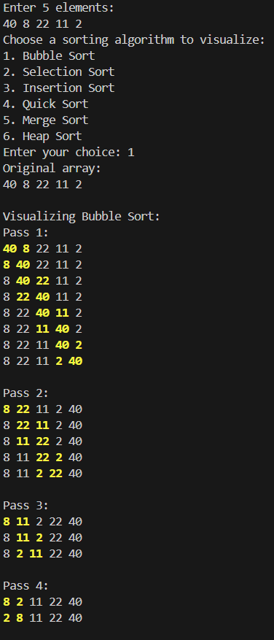

OUTPUT
BUBBLE SORT

Slide 23
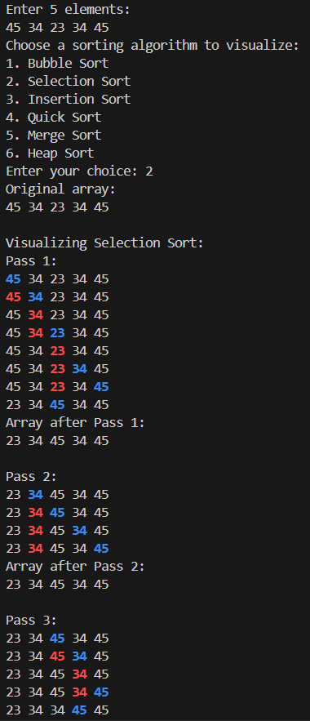
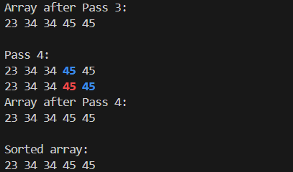
OUTPUTS
OUTPUTS
SELECTION SORT

Slide 24
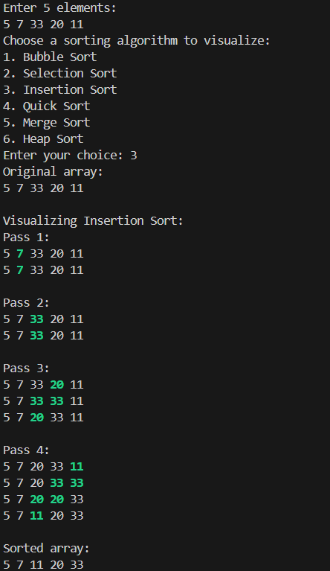
OUTPUT
INSERTION SORT

Slide 25
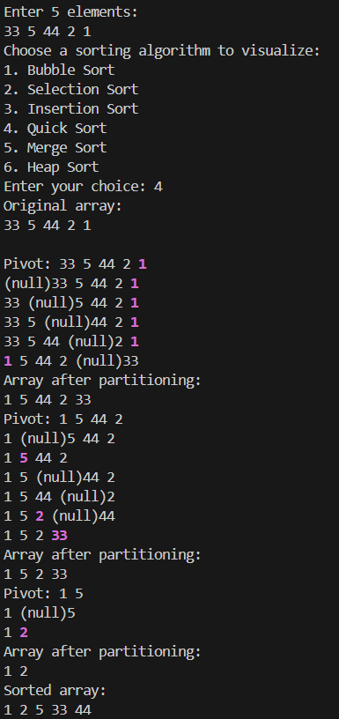
OUTPUT
QUICK SORT

Slide 26
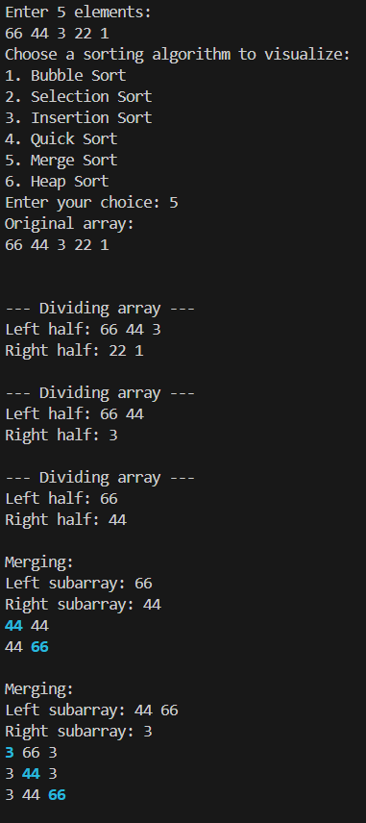
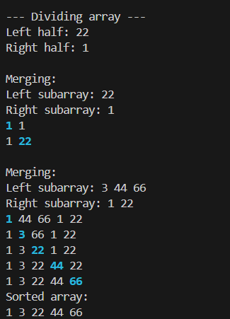
OUTPUTS
MERGE SORT

Slide 27
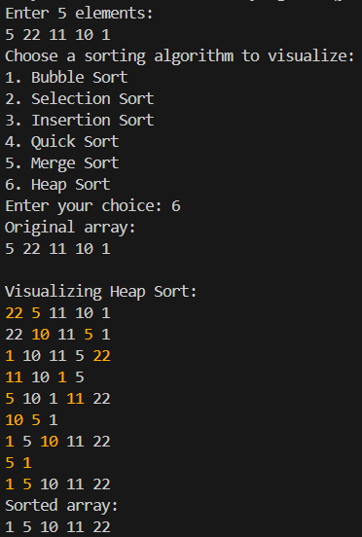


OUTPUT
HEAP SORT
ASKING THE USER TO CONTINUE OR NOT
IF YES:
IF NO:

